Slide 1
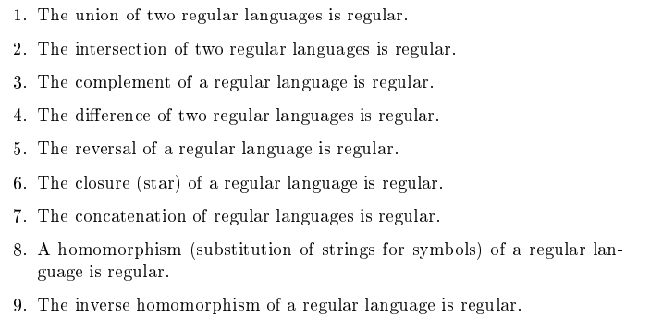
Closure Properties of Regular Sets

Slide 2
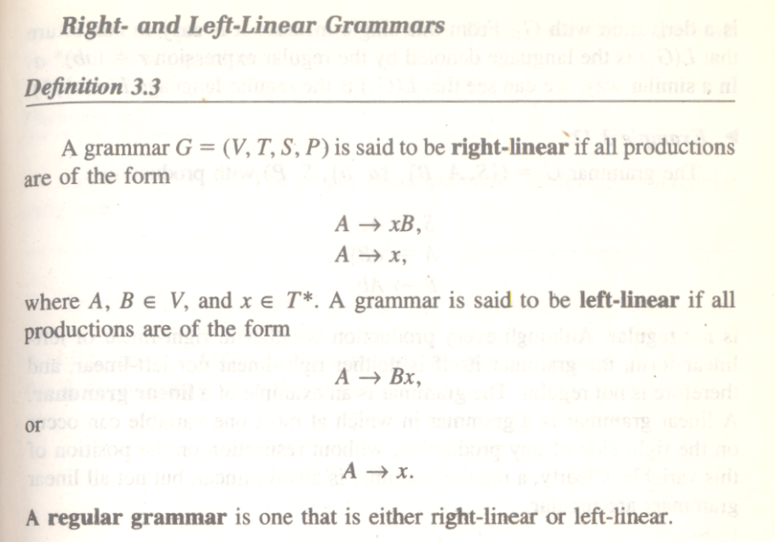
Regular grammars-right linear and left linear grammars

Slide 3
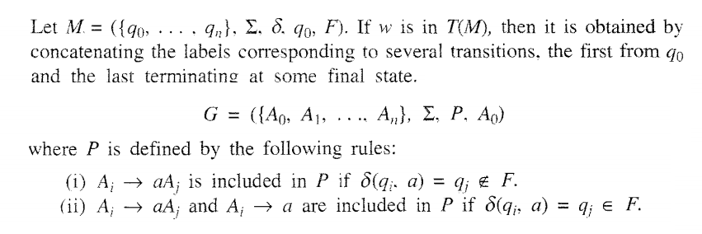
Construction of Regular Grammar T(M) Generating for a Given DFA

Slide 4
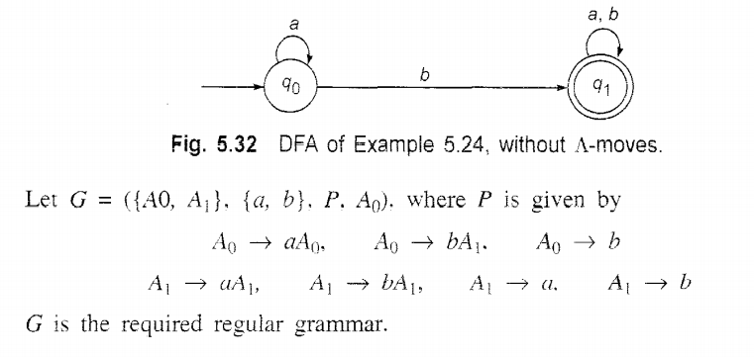
Construction of Regular Grammar T(M) Generating for a Given DFA: Example

Slide 5
Constructing a FA (Finite Automata) for given Regular Grammar (RG)
Finite Automata M = ({q0,q1,qf}, {a,b},δ, qo, {qf})

Slide 6
Problems
Construct Regular Expression to Regular Grammar for the following Expressions
i. a(a +b)*
ii. (aa +bb)

Slide 7
Problems
Convert the given Finite Automata (a+b)*ab* to Regular grammar .
Convert the given Finite Automata 0*11(0+1)*to Regular grammar
Convert Regular Expression 01* + 1 Right linear, Left linear Regular Grammars

